Slide 1

Lending Club
Loan Defaulter Prediction
OPIM-5604 Predictive Modeling
Project Team 5
Apurwa Prasad
Kumari Juhi
Manishi Kumari
Prachi Jain
Pranav Handa

Slide 2

Identifying Business Problem
Lending club is a peer-to-peer lending company that brings borrowers and private investors together
Uses Risk Assessment model to grade borrower’s case based on credit history
Gradings help investors to choose which borrower they would like to fund
Business Problem:
Identify new borrowers likely to default on their loans

Slide 3
Lending Club Analysis Overview
Identifying business problem
Data Understanding
Data Exploration
Data Modification
Classification Modeling
Bootstrapping
Boosted Tree
Logistic Regression
Conclusion
Recommendations

Slide 4
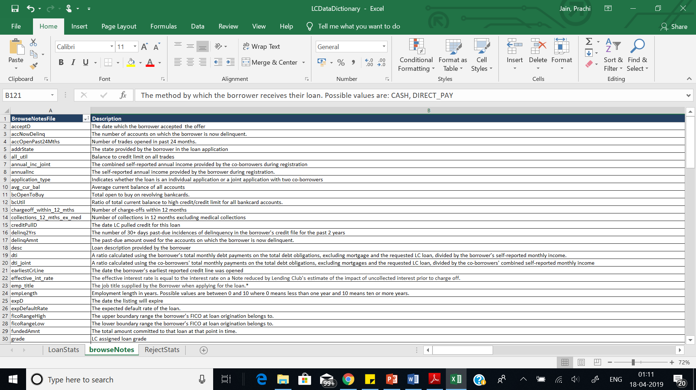
Data Understanding
Dataset consists of loan records from 2015-2018 comprising ~ 1.7 M records
Consisted of 145 variables –121 Numerical and 24 Categorical
41 key variables selected after exploratory data analysis
Standard SEMMA approach followed

Slide 5
DATA SAMPLING
There are 7 categories in Loan Status (target variable):
Considered Late (16-30 days), Late (31-120 days), Default, Charged Off under “Default” category
Fully Paid is a desirable loan category
Current and Grace Period loans are ignored as their final status is unknown
After removing Current and Grace Period status data, data set has been reduced to ~0.8 M

Slide 6
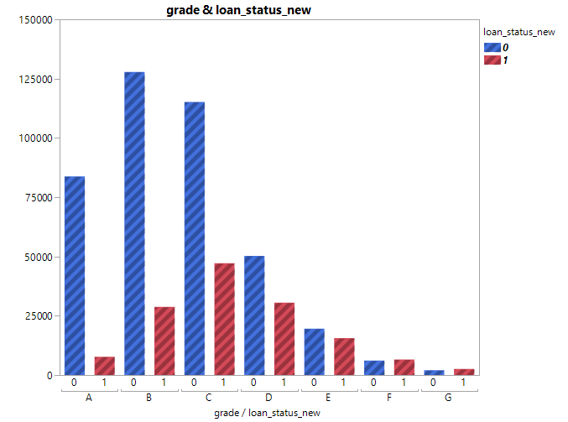
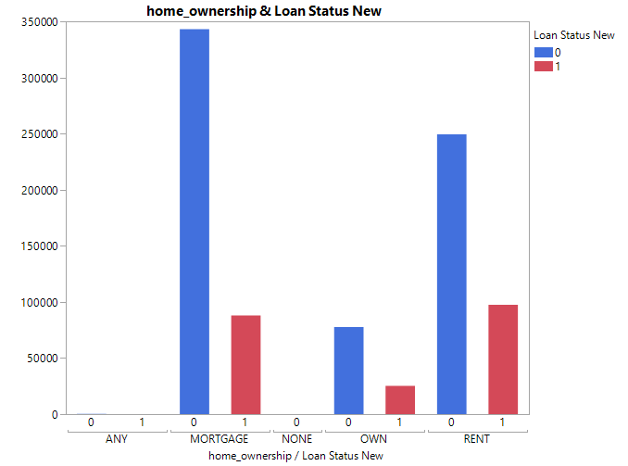
Data exploration
Grade vs Loan Status
Home Ownership vs Loan Status
Grading based on credit score and other customer KPIs
Loan defaulter's ratio increases across grades from A to G
People who have mortgages and live in rented house are more likely to default as compared to those who own a house

Slide 7
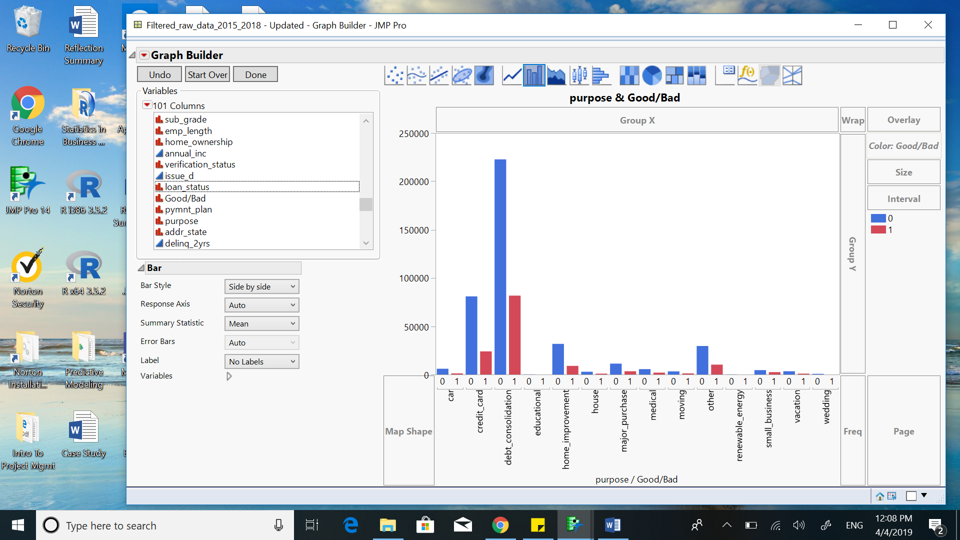
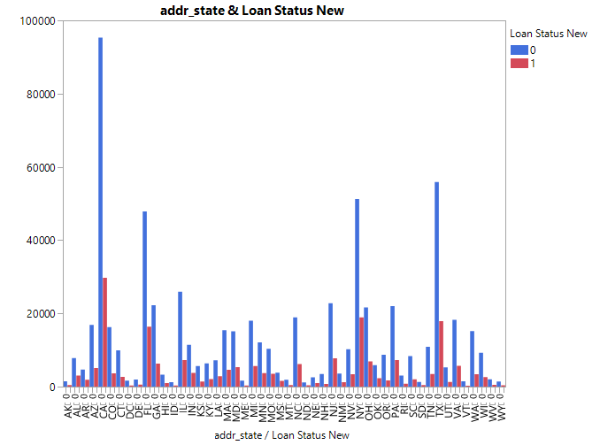
Data exploration
Purpose vs Loan Status
Address State vs Loan Status
Majority of loan were taken for debt consolidation
Few took loan for credit card payment and other purposes
38.2% lending Club borrowers are from California, Texas, New York, and Florida
Coherent to GDP ranking of these states

Slide 8
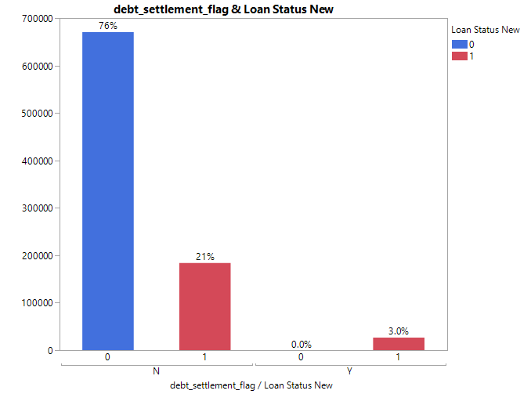
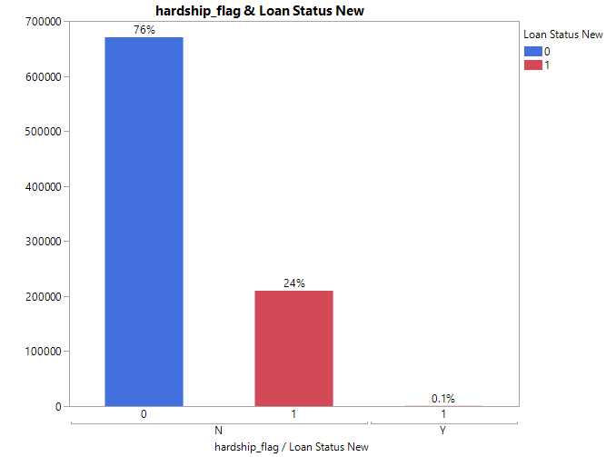
Data exploration
Debt Settlement vs Loan Status
Hardship vs Loan Status
3% of the total borrowers are associated with a debt settlement company
Such borrowers are 100% defaulters
0.1 % of total borrowers took hardship plan
100% of them are loan defaulters

Slide 9
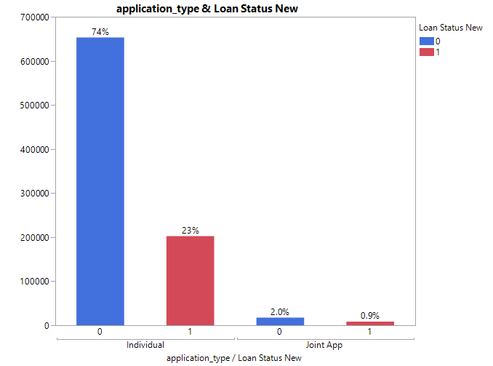
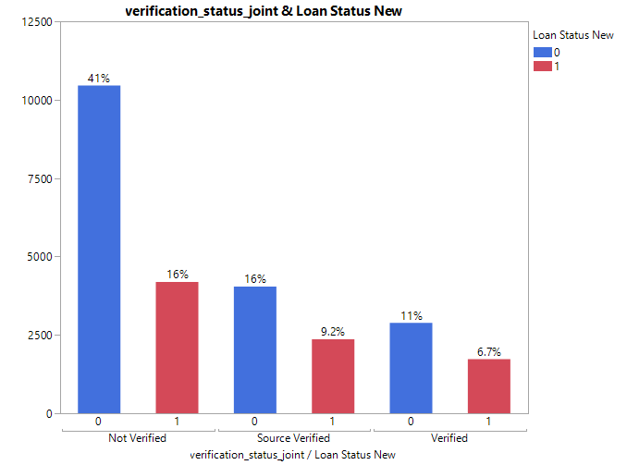
Data exploration
Application Type vs Loan Status
Verification Status vs Loan Status
97% of total borrowers hold individual account
Borrowers whose income source has been verified are more likely to default

Slide 10
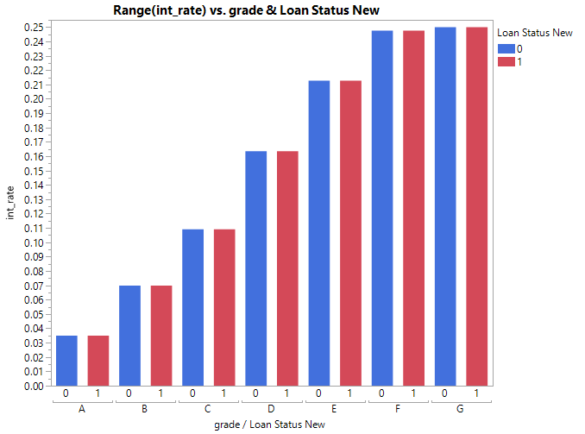
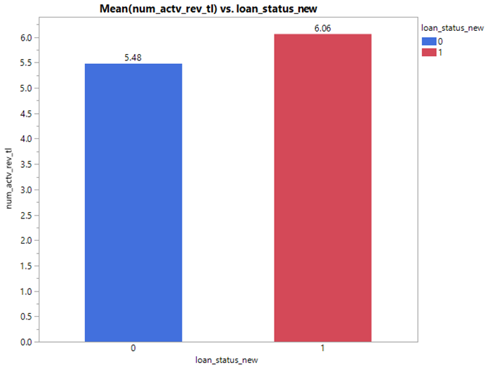
Data exploration
Interest rate by Grade and Loan Status
Total active revolving trades vs Loan Status
Grading indicates groups based on loan interest rate
Higher the interest rate, higher the probability to default the loan by the borrower
Defaulters have higher average number of revolving trades than non-defaulters

Slide 11
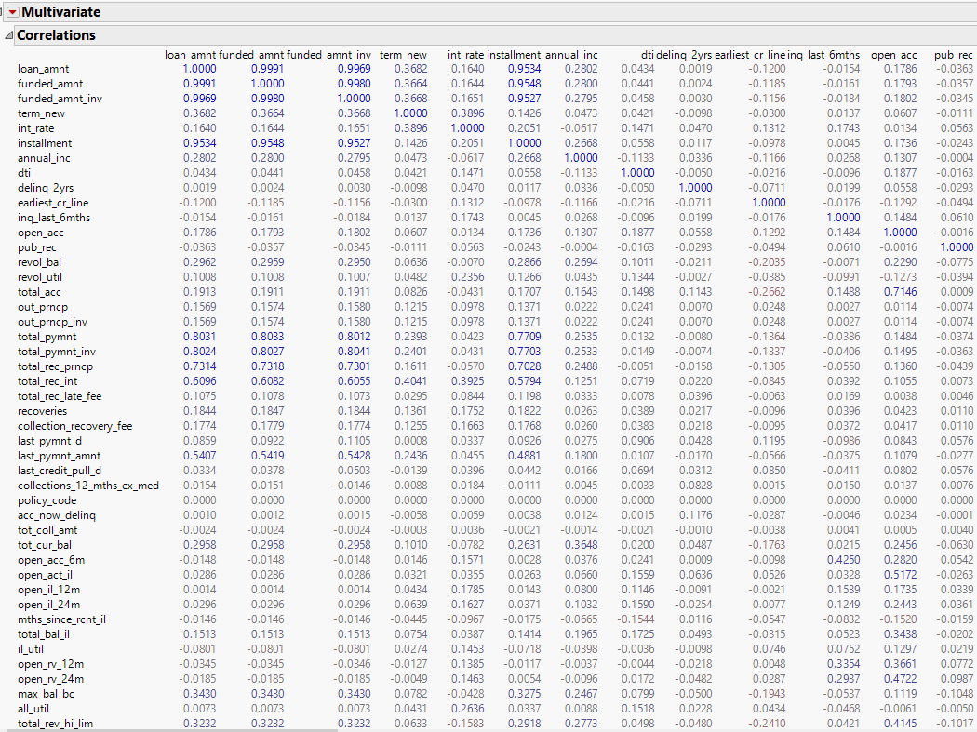
Data exploration
Removed variables which have high correlation, signifying redundant information
Example-: Installment and Loan Amount have high correlation of 0.953
Out_prncp and out_prncp_inv have a very high correlation of 1

Slide 12

Data modification – MISSING VALUES AND IMPUTATION
Removed 49 variables with over 50% of missing data
Removed another 9 variables which had 35% of missing data and couldn’t be imputed
Imputed data for rest of the variables with missing values (max~2.8%)
Removed variables with irrelevant information. Example-: ID, Employee Title
Removed independent variables having high correlation with each other
Example-: Funded amount, Total funded Amount as they are equivalent to loan amount

Slide 13
DATA MODIFICATION
Imputation
Feature Engineering
After dropping variables with more than 35% missing data, remaining variables with max of ~2.8% of missing data were imputed
Principal Component Analysis:
A dimensionality reduction technique to reduce model complexity while achieving better model performance
24 variables out of 31 continuous variables were considered for model, retaining ~94% of information in data

Slide 14
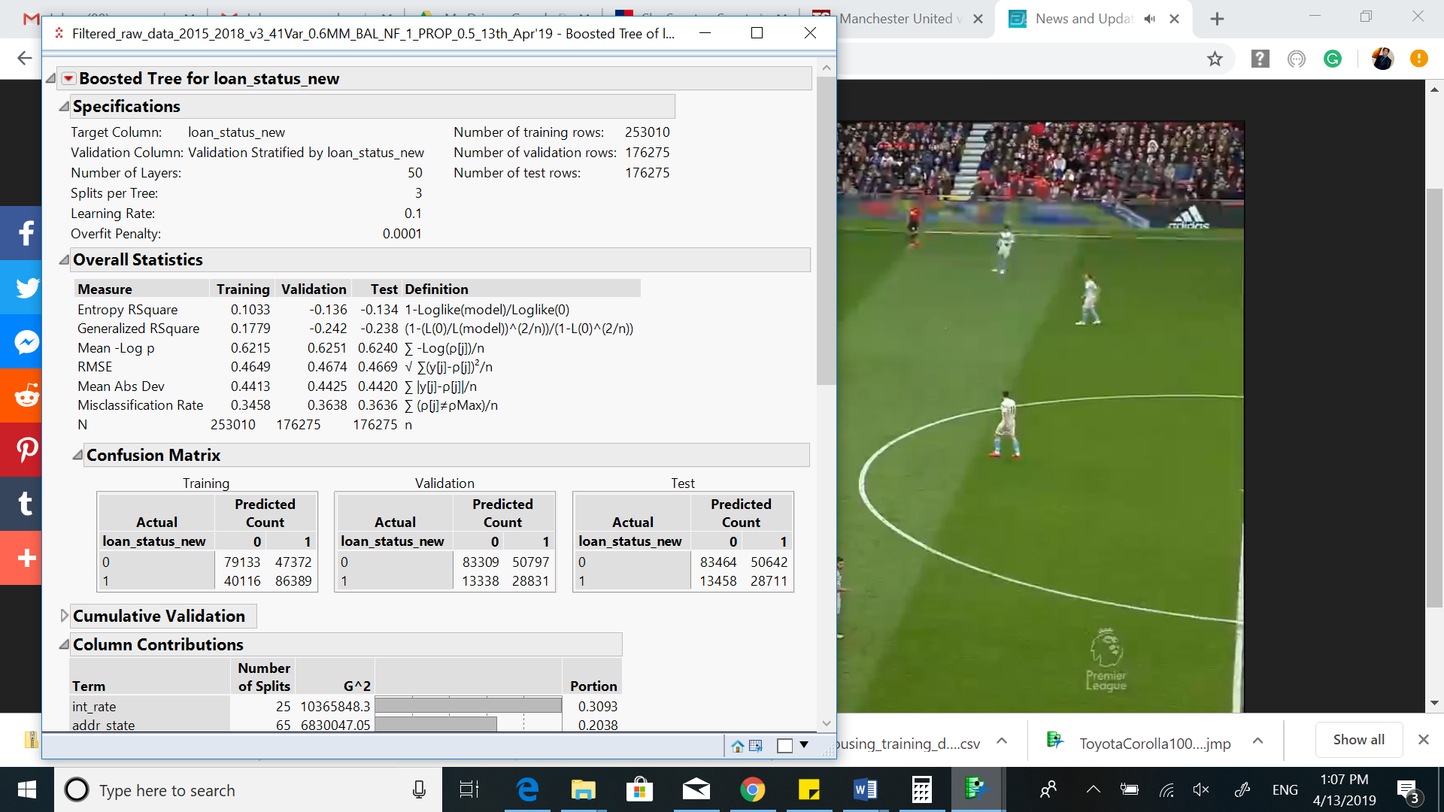
CLASSIFICATION MODELS - BOOSTED TREE
Fit Details (Stratified Sample Test Data)
Total Accuracy | 64%
Yes Accuracy | 36.18%
Sensitivity | 68%
ROC | 71.23%

Slide 15
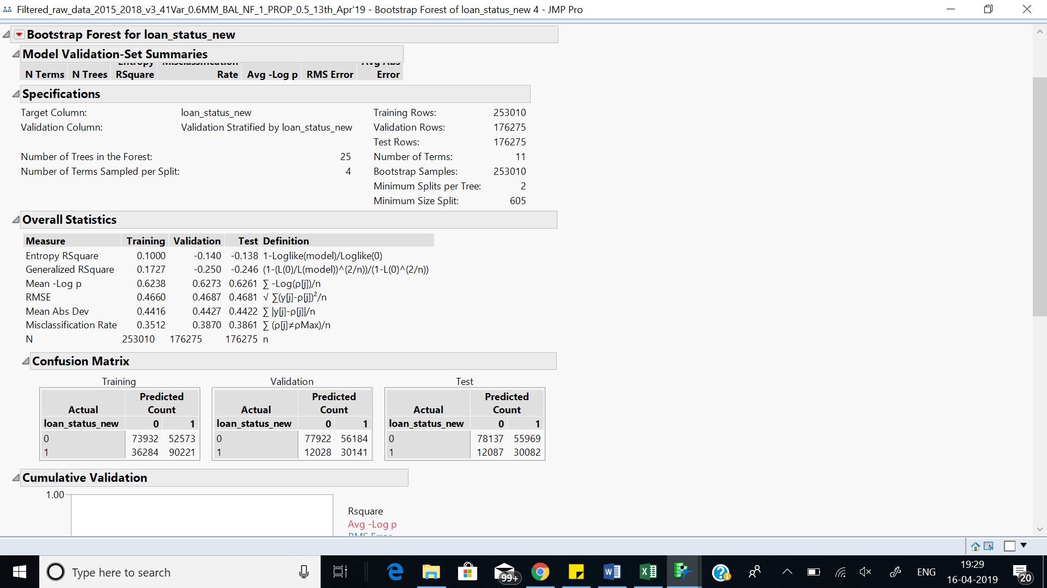
CLASSIFICATION MODEL-BOOTSTRAPPING
Fit Details (Stratified Sample Test Data)
Total Accuracy | 61.39%
Yes Accuracy | 34.95%
Sensitivity | 71.5%
ROC | 70.90%

Slide 16
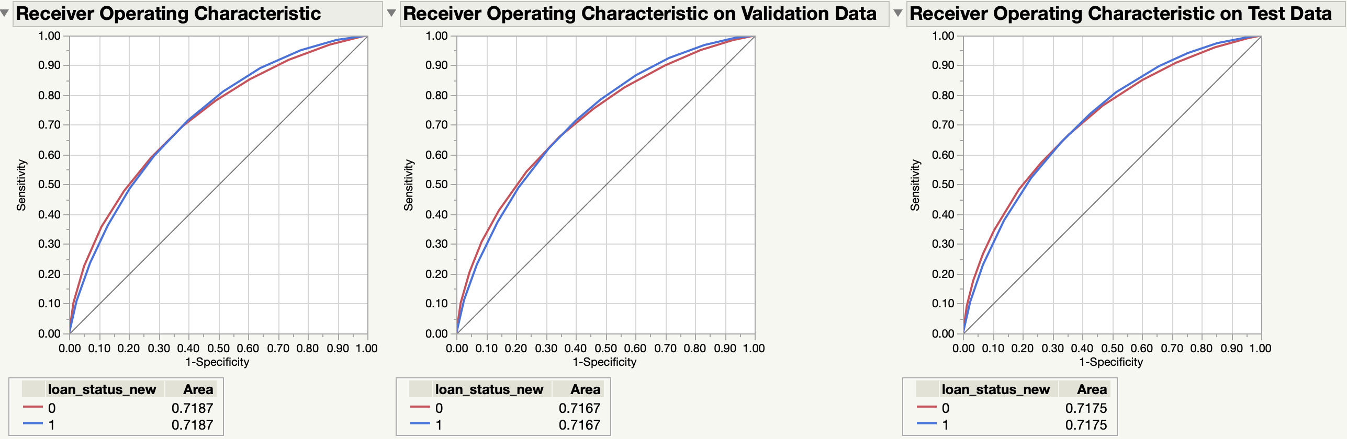
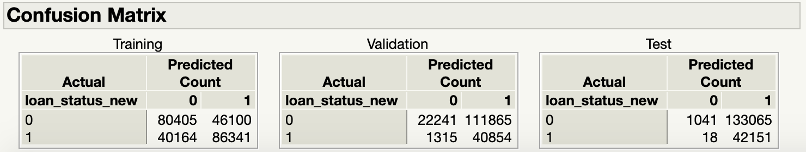
CLASSIFICATION MODEL-logistic regression using pca’S
Fit Details (Stratified Sample Test Data)
Total Accuracy | 24.5%
Yes Accuracy | 24.05%
Sensitivity | 99.95%
ROC | 71.75%

Slide 17
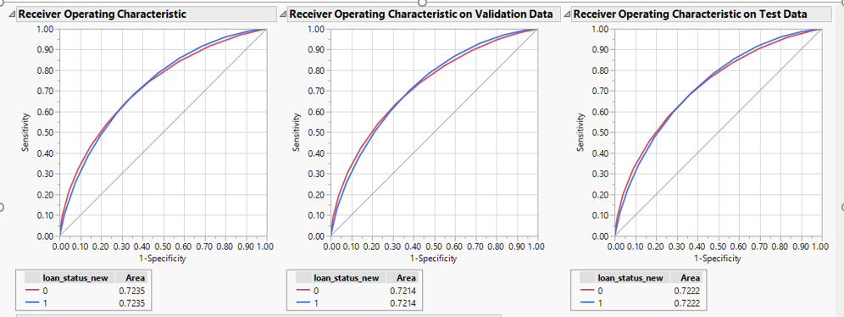
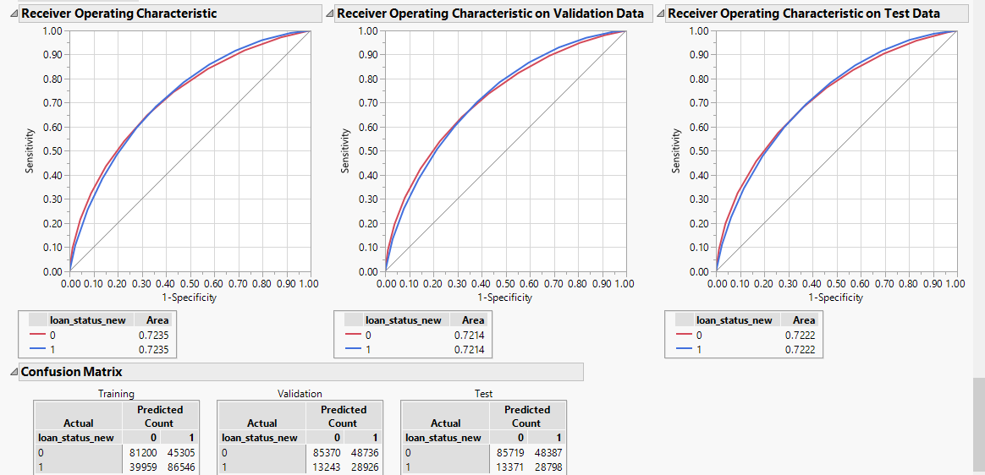
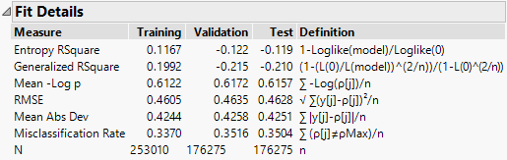
CLASSIFICATION MODEL - Logistic regression

Slide 18
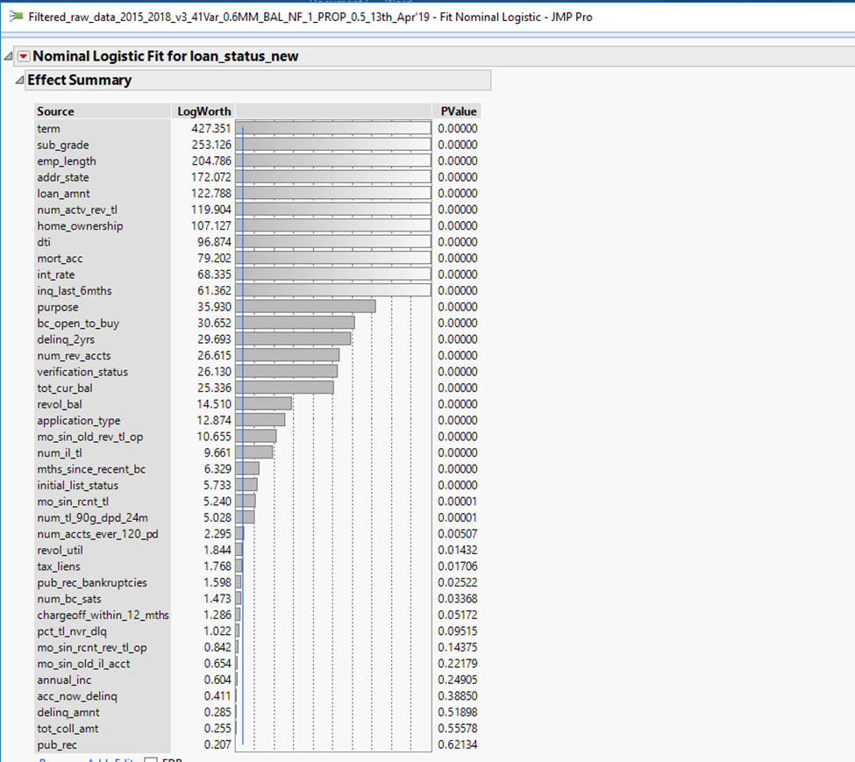
LOGISTIC REGRESSION
Fit Details (Stratified Sample Test Data)
Total Accuracy | 64.96%
Yes Accuracy | 37.31%
Sensitivity | 68.29%
ROC | 72.22%

Slide 19
MODEL comparison
S.No. | Data Sample | Method | Overall Accuracy | Precision | ROC | Sensitivity
1. | Random | Bootstrap | 76.37% | 64.20% | 70.83% | 2.93%
2. | Random | Boosted | 76.56% | 62.26% | 71.15% | 4.14%
3. | Random | Logistic | 76.94% | 57.23% | 72.28% | 14.19%
4. | Random | PCA - Logistic | 76.74% | 57.12% | 71.63% | 12.77%
5. | Stratified | Bootstrap | 61.39% | 34.77% | 70.27% | 70.24%
6. | Stratified | Boosted | 63.70% | 36.18% | 71.23% | 68.08%
7. | Stratified | Logistic | 64.96% | 37.31% | 72.22% | 68.29%
8. | Stratified | PCA - Logistic | 24.50% | 24.05% | 71.75% | 99.95%

Slide 20
CONCLUSION
Logistic regression with stratified sampling was identified as the best model among the others
Key features that contributed to predicting defaulters – term, grade, employee length, debt-to-income ratio, state, home ownership, number of active revolving trades, number of inquiries in past 6 months, etc.

Slide 21
RECOMMENDATION
Investors should closely scrutinize the borrower’s profile like grade assigned by Lending Club (preferably between A to C) in conjunction with the state they belong to (high GDP states), in order to choose their borrowers
Lenders should also analyse their type of home ownership (preferably who own a house)
Borrowers with more than six inquiries (on an average) have higher rate of defaulting as compared to those with lesser inquiries, hence, prefer those with lower number of inquiries
Borrowers with lower debt-to-income ratio (<20.7 on an average) should be preferred by lenders

Slide 22
Lending Club
Loan Defaulter Prediction
OPIM-5604 Predictive Modeling
Project Team 5
Apurwa Prasad
Kumari Juhi
Manishi Kumari
Prachi Jain
Pranav Handa

Slide 23
Appendix

Slide 24
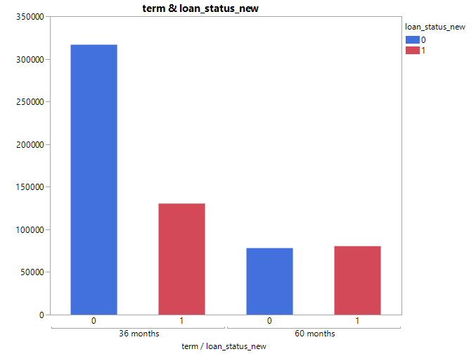
Term vs Loan_Status_New

Slide 25
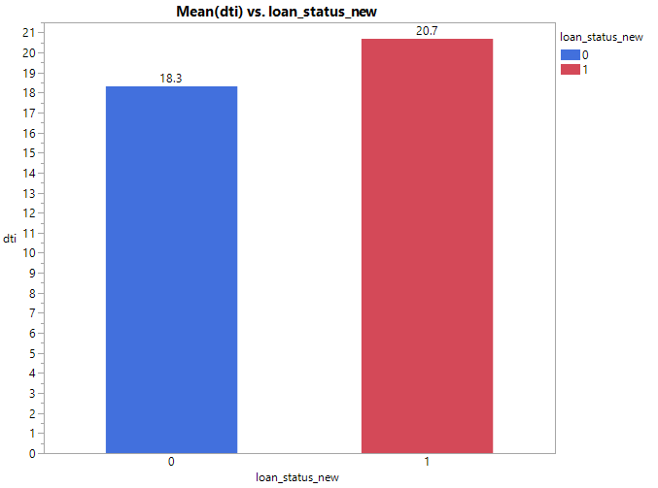
Mean(dti) vs loan_status_new

Slide 26
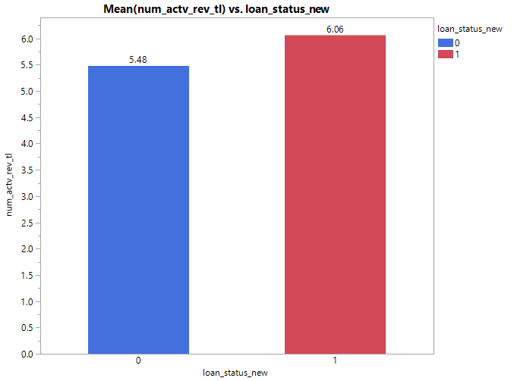
Mean(num_actv_rev_tl) vs loan_status_new

Slide 27
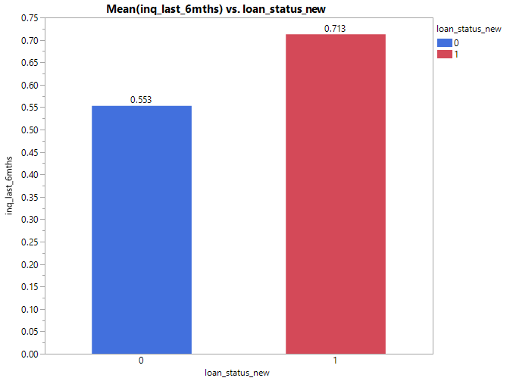
Mean(inq_last_6mths) vs loan_status_new

Slide 28
Logistic Regression – using PCAs with stratified data
Confusion Matrix
Fit Details (Stratified Sample Test Data)
Total Accuracy | 24.5%
Yes Accuracy | 24.05%
Sensitivity | 99.95%
ROC | 71.75%
ROC Curve

